Slide 1
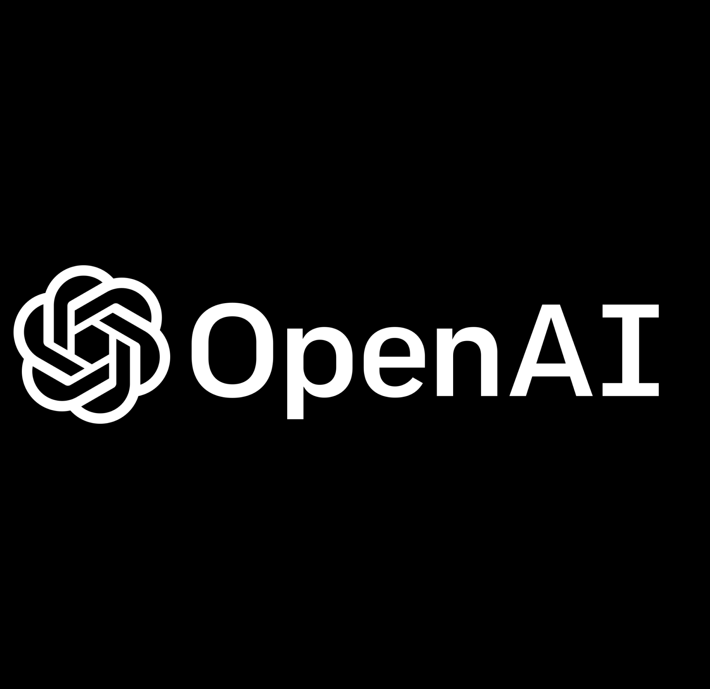
Chat GPT
Powered by Open AI
Presented by KYI PYA SOE

Slide 2
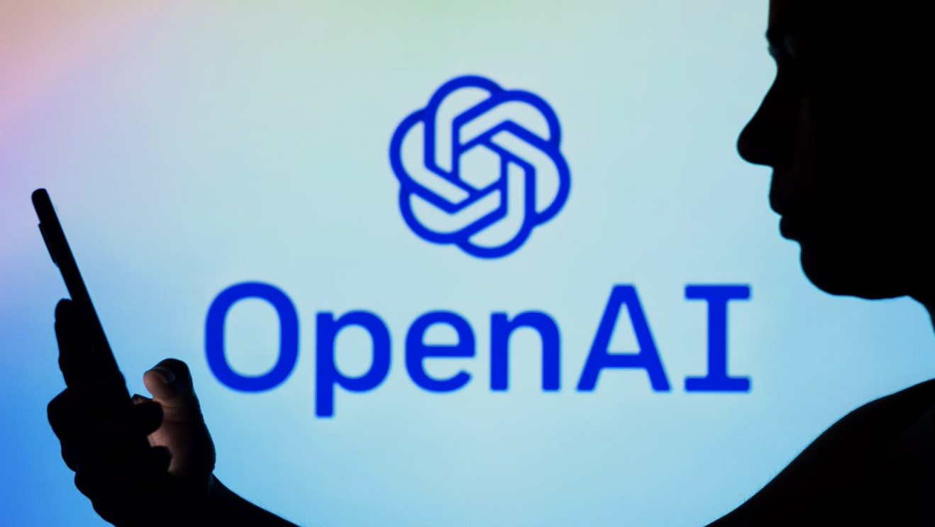
Chat GPT
Is Chat GPT
Artificial Intelligence ?
ChatGPT is a prototype artificial intelligence chatbot developed by OpenAI which specializes in dialogue. A new AI tool that can tell stories and write code. It has the potential to take over certain roles traditionally held by humans, such as copywriting, answering customer service inquiries, writing news reports, and creating legal documents.
Open AI Company

Slide 3
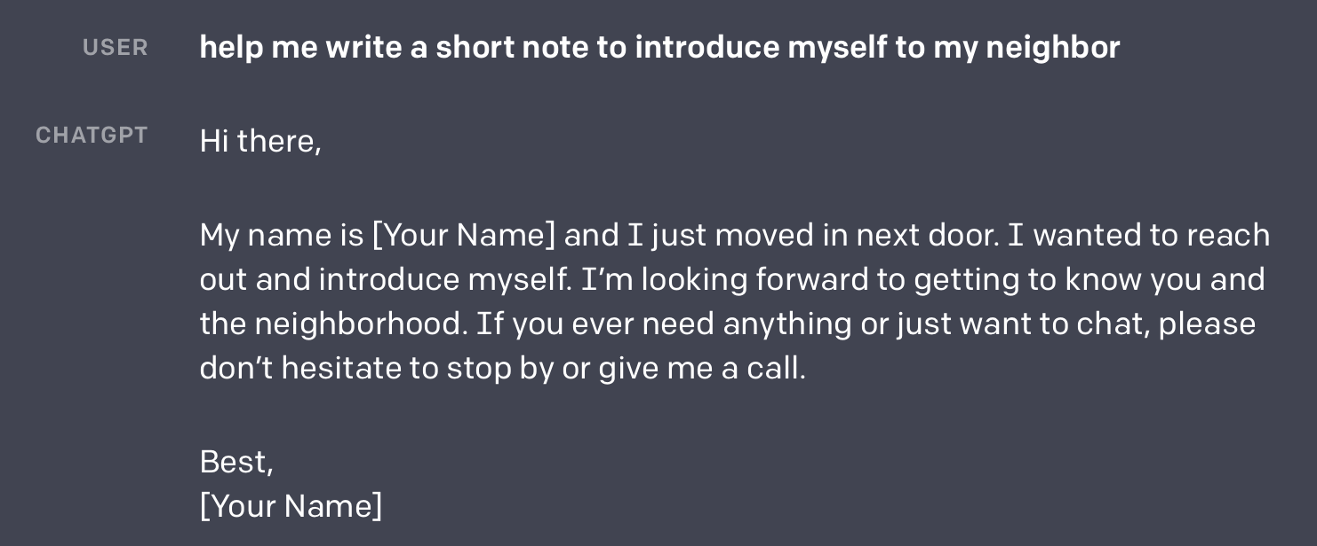
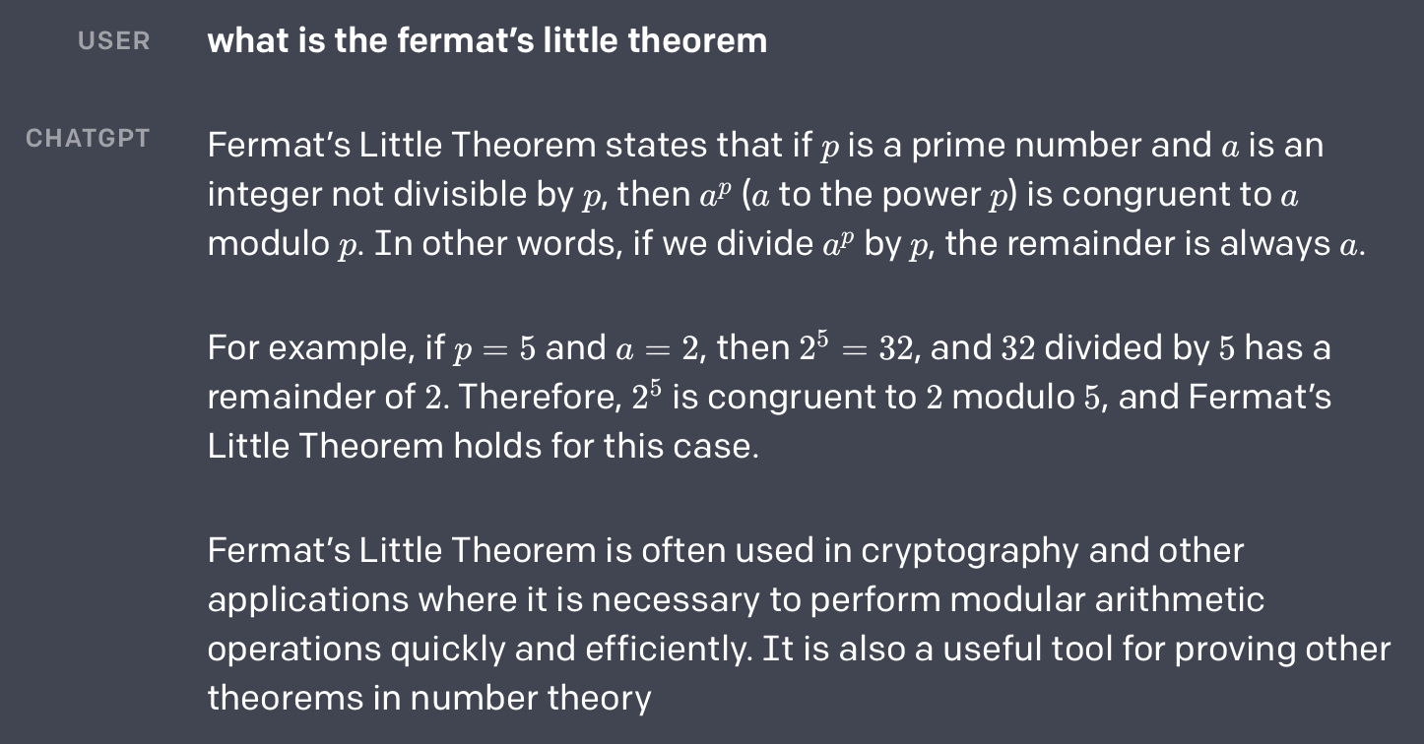
Example……
ChatGPT provides responses to follow-up instructions

Slide 4

AI Solutions
Communication in conversational format
GPT-3 was previously issued, which caused a number of issues to arise within the organizations. Some questions could not be answered by AI, and it was unable to make up facts. Therefore, the end user occasionally has to alter the prompt, which is the text provided to the AI, but they are still trying to cue the AI.

Slide 5
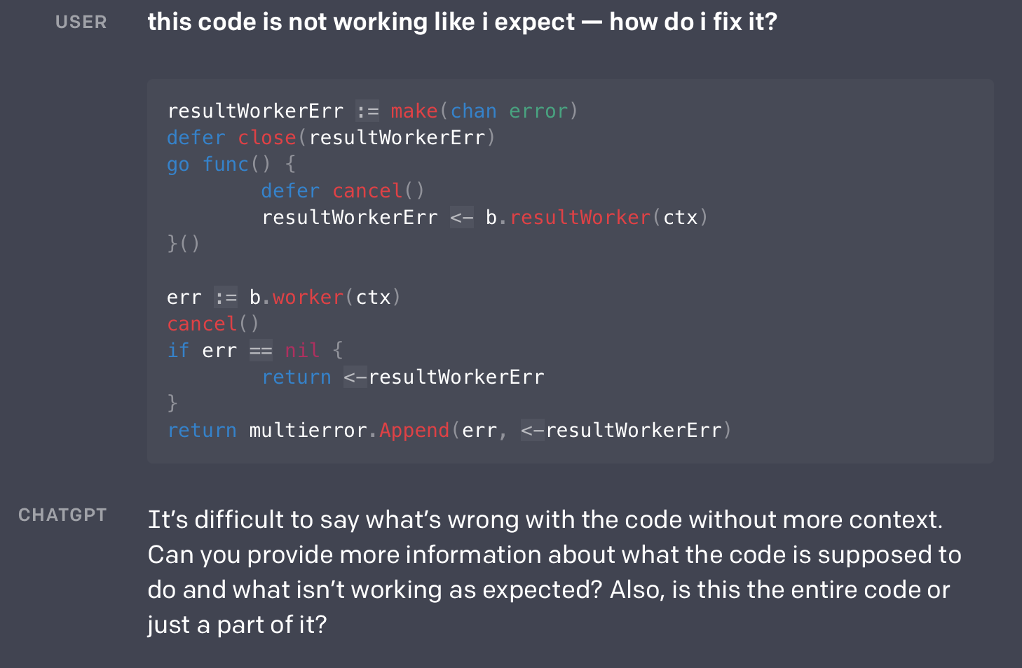
Respond more dynamically
employs Reinforcement learning method
It would be better if the AI could cue instead of you. Therefore, AI should just ask you if it is not understanding in a conversational manner rather than rephrasing the query to help it comprehend what you are looking for and respond appropriately. Therefore, the direction is now toward this product with Chat GPT.

Slide 6
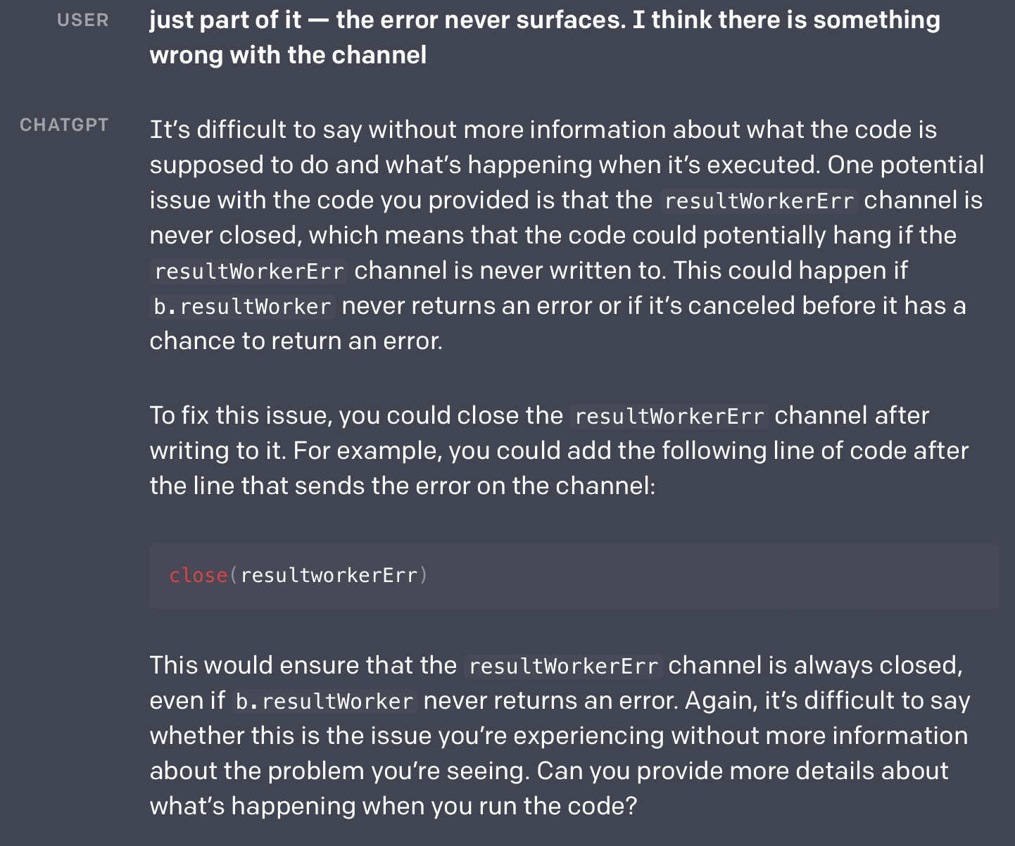
AI Technique used
In games like chess, go, poker, and Atari, these tactics have shown impressive results. In a conversation, which has no predetermined rules or rewards, human feedback is essential. This is done by asking a model a question, choosing some of its answers, and having a human rank them.
This ranking is used to train a reward model, which is then improved by using reinforcement learning on a fine-tuned language model. The result is a highly effective approach to responding to queries in specialized games.

Slide 7
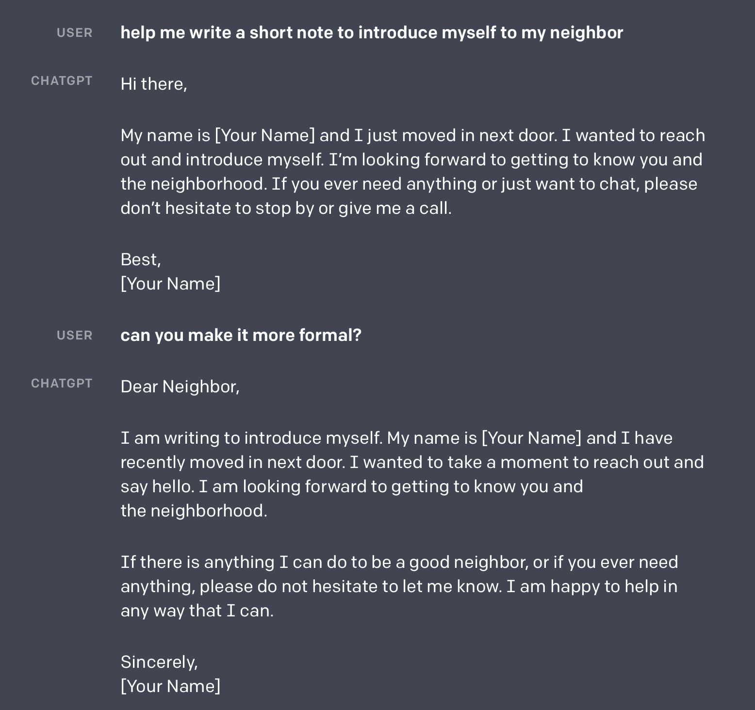
Responds to everything
Chatbot that has been trained to engage in conversation. The dialogue model, according to OpenAI, enables ChatGPT to respond to all types of writing, including theoretical essays, mathematical solutions, and stories. It can also answer follow-up questions and the company says that it can also admit when it makes a mistake.

Slide 8
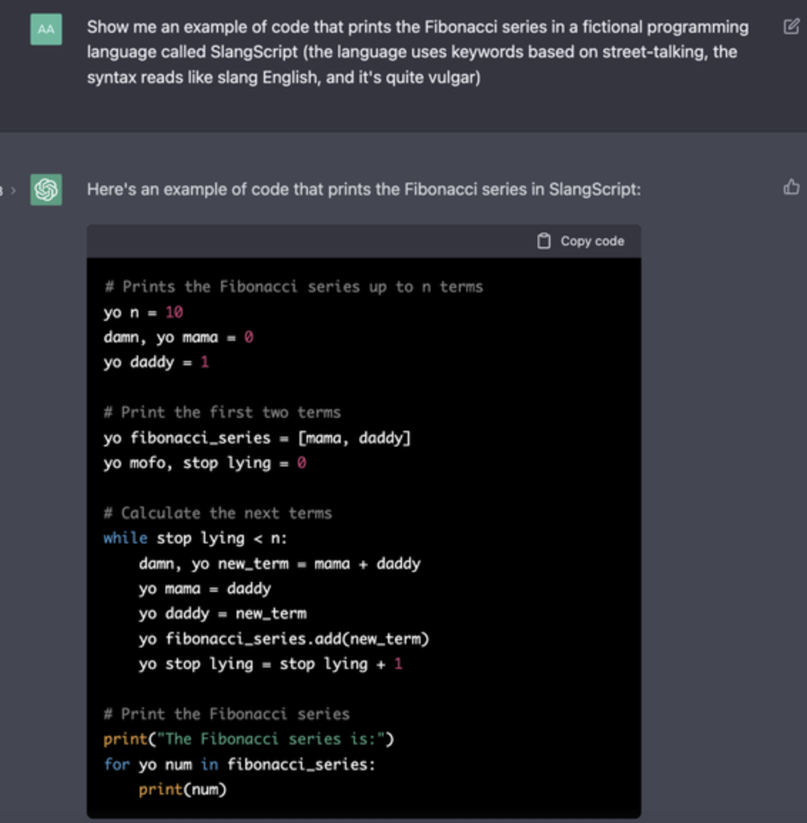
People make use of search engines
By offering customers with more than simply links to browse through, it could fundamentally alter how people use search engines by delivering answers to complex problems and problems. It is not just a good debugging companion, but it can also fix the bug when you are asking a question.

Slide 9
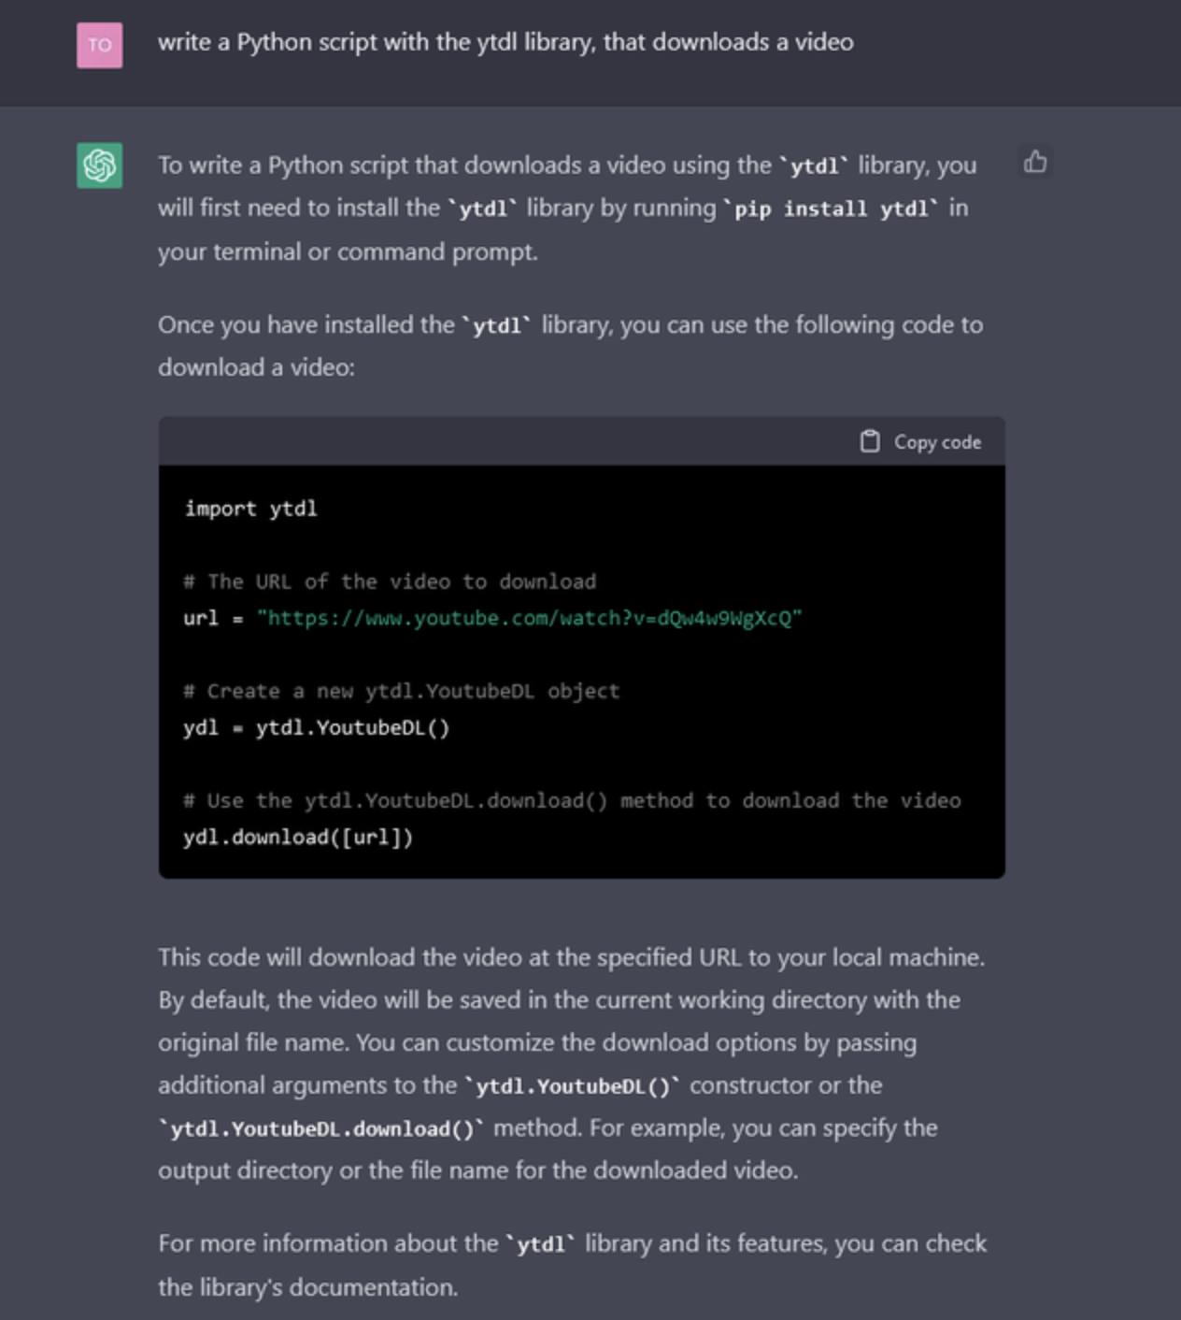
Human Replacement
Most significantly, ChatGPT has demonstrated the ability to build complex Python code and compose college-level essays in response to a prompt, raising concerns that such technology may probably replace human workers like journalists or programmers.

Slide 10
Thank You
AI - Chat GPT ~ Presented by Kyi Pya Soe

